Slide 1
/*{ CODE JUDGE }*/
Developers:
Gaurav Rajput
Divyank Pahlazani
Himanshu Nigam

Slide 2
What is Code Judge
Code Judge is a web portal where online coding examinations can be conducted or the user can enhance their skills by attempting the coding challenges.
There will be mainly two users: Examiner, who can conduct the test on the portal and Students, who will attempt them.
On submitting, the code will be executed on the server and the result will be displayed to the student in form of a green tick if correct else a red tick.

Slide 3
What is Code Judge (cont.)
For every program there will be certain test cases that the code should pass in order to be accepted. After a code is accepted a green tick will be shown to the student.
At the end of the examination a Leader Board will be generated, it will have the names of students in order of their marks or completion time.

Slide 4
What is Code Judge (cont.)
Usually students copy their code from others, in order to prevent copying of code SOCO module is used.
The examiner will be able to see the percentage of similarity in the code using SOCO module.

Slide 5
Need for Code Judge
Whenever coding examinations are conducted, the students are required to write a program and the examiner needs to check the program of each and every student individually.

Slide 6
Need for Code Judge (cont.)
So, Code Judge will allow the examiner the flexibility to conduct tests, the Code Judge will examine all the submitted codes by students and check all at once whose program has been executed and grade them accordingly, this will save the time and extra work of the examiner.

Slide 7
Need for Code Judge (cont.)
Many times students copy and paste the programs therefore Code Judge will also provide the functionality for preventing copying and pasting any pre written programming code, this ensures that students write the program with their own knowledge.

Slide 8
Modules
Front End Module
Compilation Module
Test Case Module
Result Module
SOCO Module

Slide 9
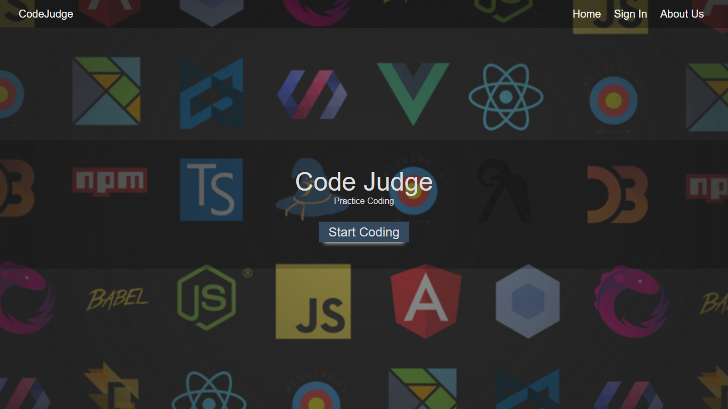

Slide 10
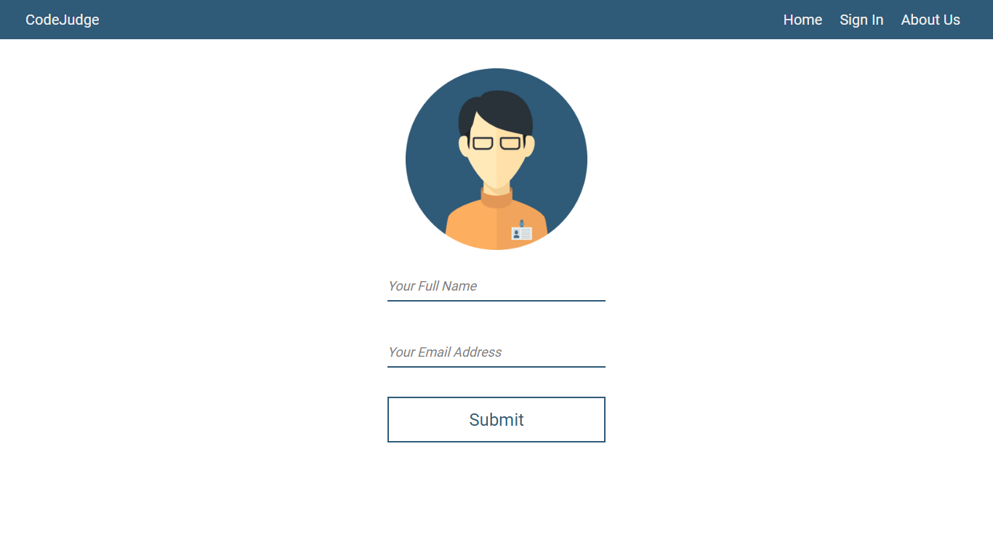

Slide 11
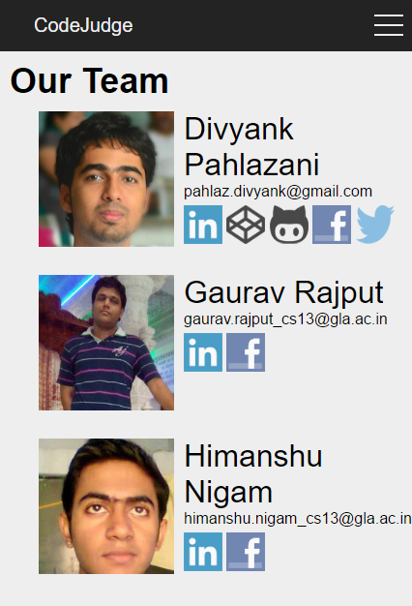

Slide 12
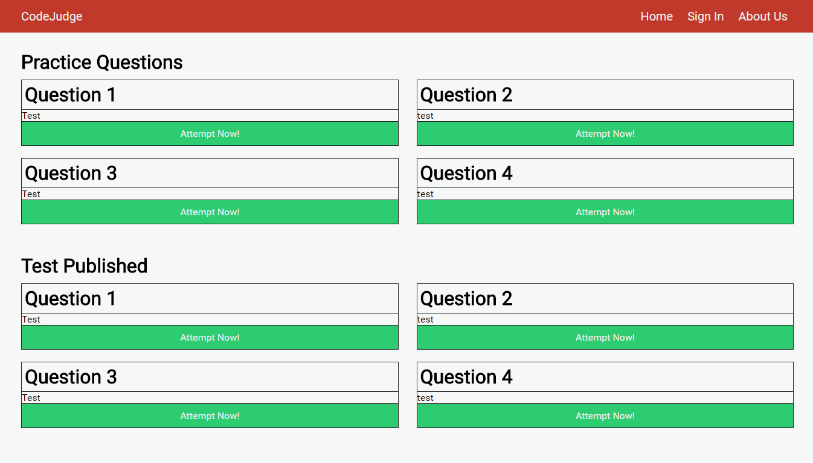

Slide 13
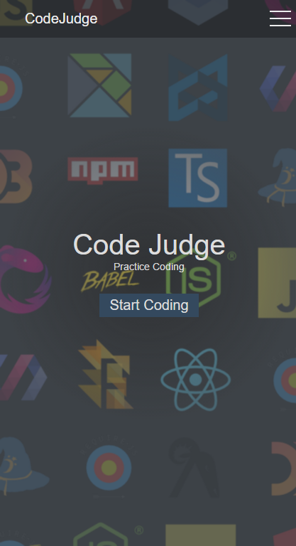
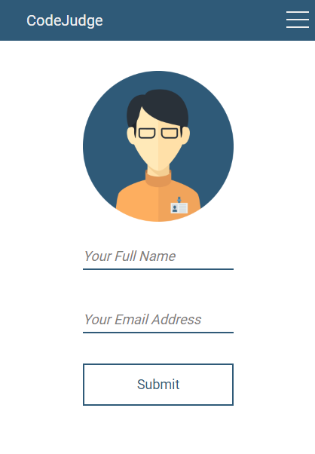
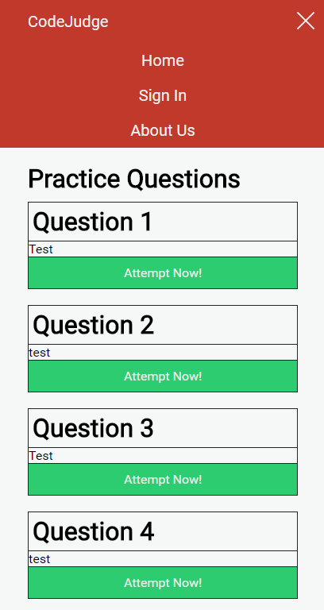

Slide 14
THANK YOU
Any Questions?

